Slide 1
數位IC設計 作業解說
NCKU CSIE DICLAB

Slide 2
The simulation process
The simulation process and the necessary tools
The tools and tutorial for setup can be downloaded from :
https://www.intel.com/content/www/us/en/software/programmable/quartus-prime/download.html#
Functional simulation
Synthesis
Gate Level simulation
ModelSim
Quartus
ModelSim

Slide 3
Download and install Quartus and Modelsim

Slide 4
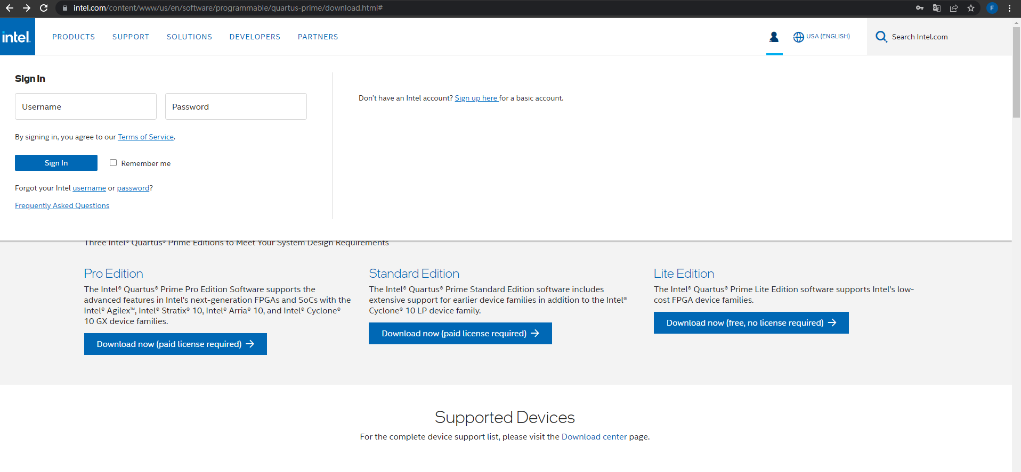
Download and install Quartus and Modelsim
Step 1: Register and sign in
1. Click here to expand the window below
2. Register Here

Slide 5
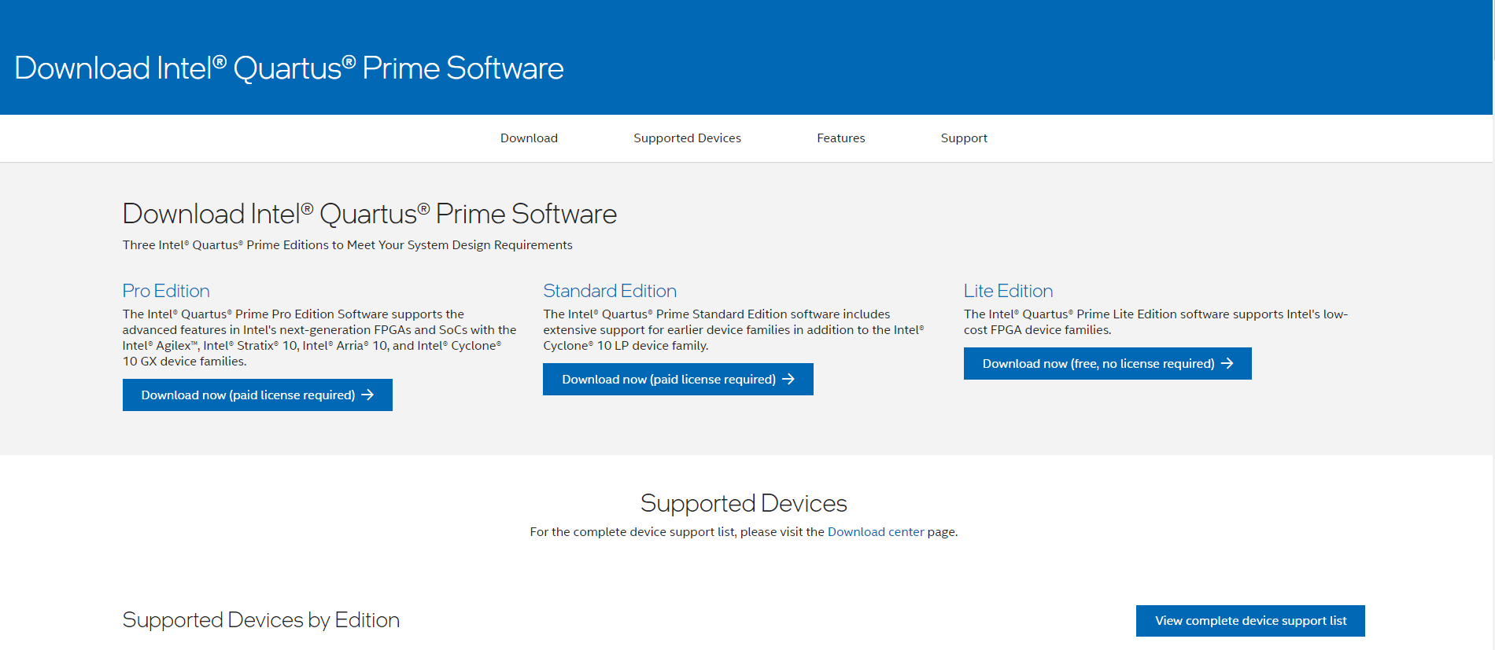
Download and install Quartus and Modelsim
Step 2: Click “ View complete device support list “
Click Here

Slide 6
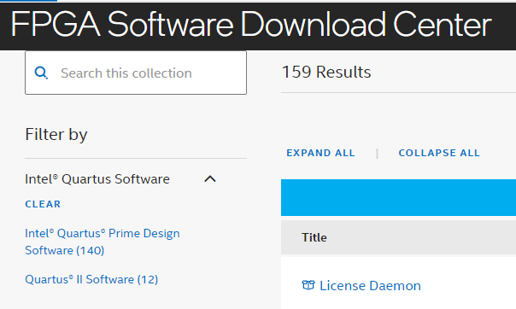
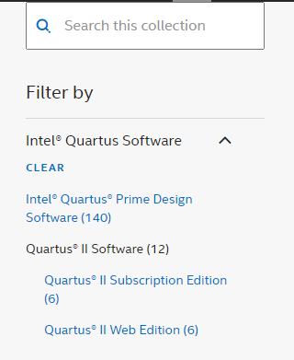
Download and install Quartus and Modelsim
Step 3: Click Quartus II Software -> Quartus II web Edition
1. Click Here
2. Click Here

Slide 7
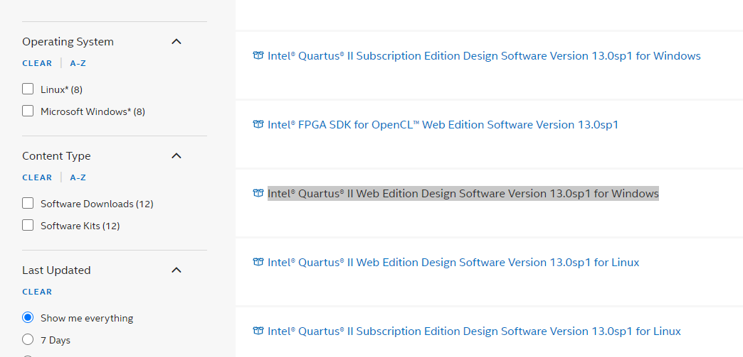
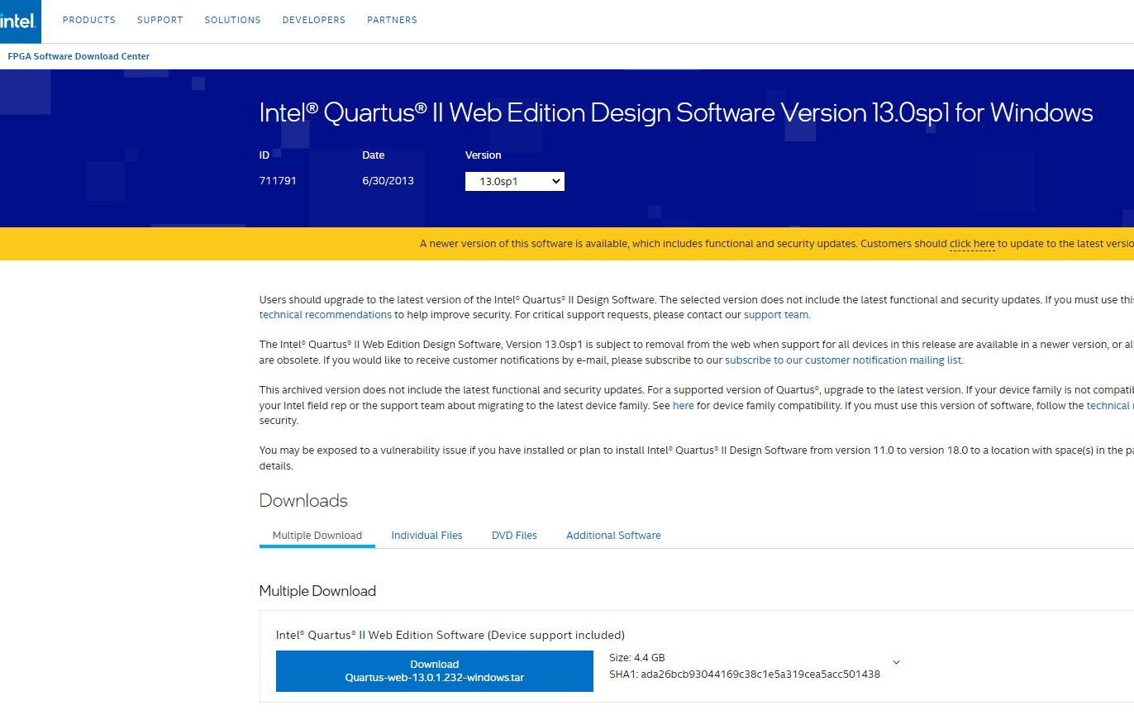
Download and install Quartus and Modelsim
Step 4: Download Intel® Quartus® II Web Edition Design Software Version 13.0sp1 for Windows
1. Click here to open the download page
2. Click here to download

Slide 8
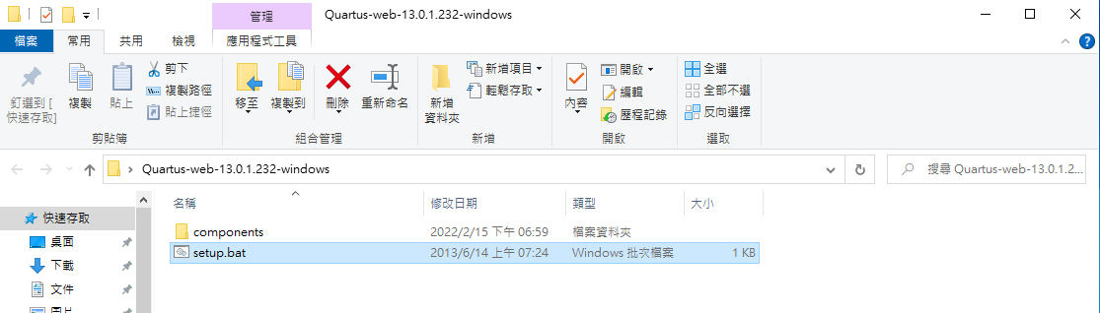
Download and install Quartus and Modelsim
Step 5: Open setup.bat to install the Quartus and Modelsim

Slide 9
Functional Simulation by ModelSim

Slide 10
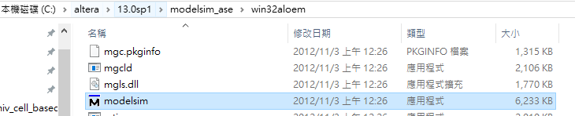
Functional Simulation by ModelSim
Step1: Run modelsim.exe
Your quartus installation path
Ex: C:/altera/13.0sp1/modelsim_ase/win32aloem/modelsim.exe

Slide 11
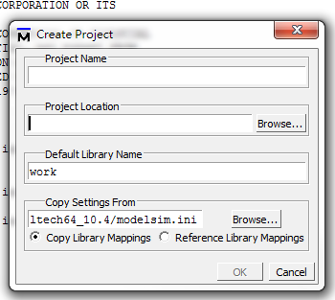
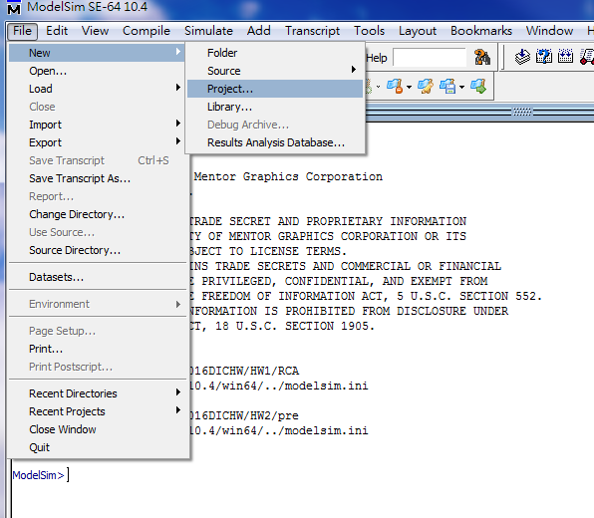
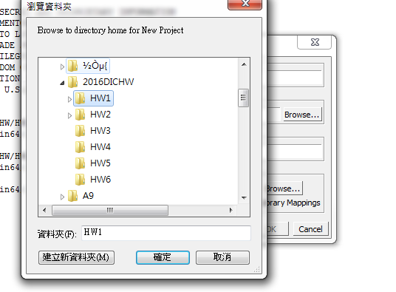
Functional Simulation by ModelSim
Step2: Create a new project
File -> New -> Project
Click “Browse…”
The name of your project
Click here
The file path should be ALL ENGLISH
The location of your project

Slide 12
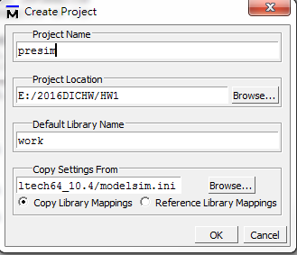
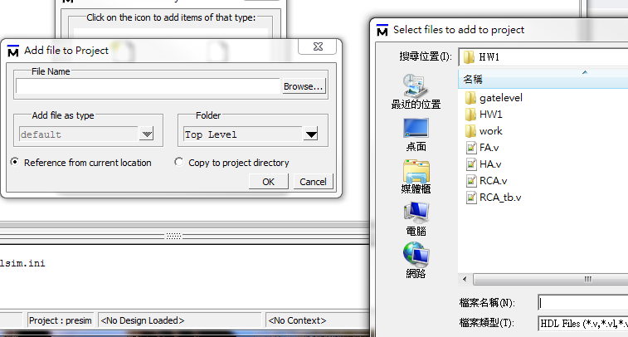
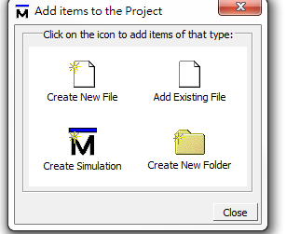
Functional Simulation by ModelSim
Step 2: Add the files
Select all the files including the testbench
Verilog code could be stored in any location , “add existing file” would refer to the file location automatically .
Remember to put the test data and golden data at the same directory of the testbench file.
Click here
Click here
Click here

Slide 13
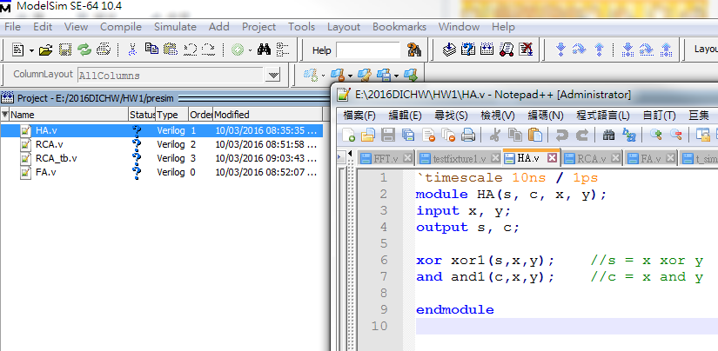
Functional Simulation by ModelSim
Step3 : Start coding…

Slide 14
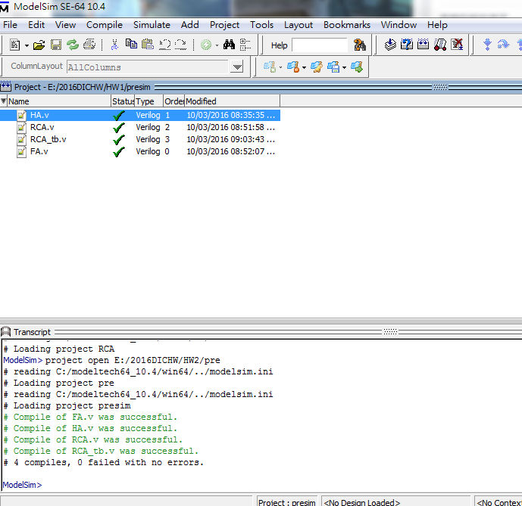
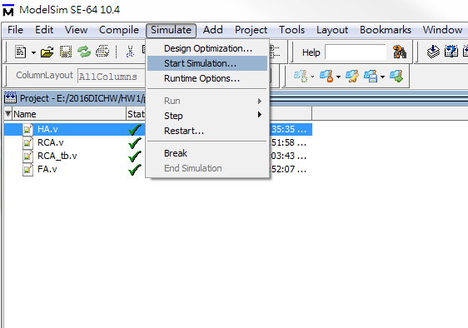
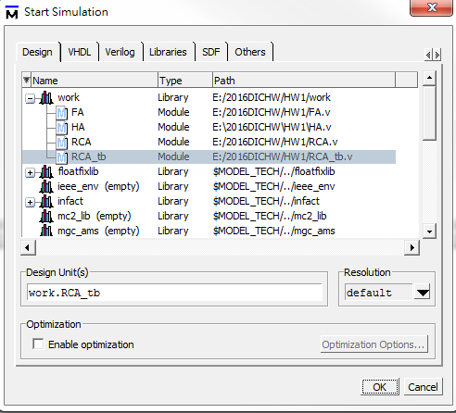
Functional Simulation by ModelSim
Step4: Compile & Start simulation
Compile -> Simulate -> Start Simulation->work->testbench file
Click here

Slide 15
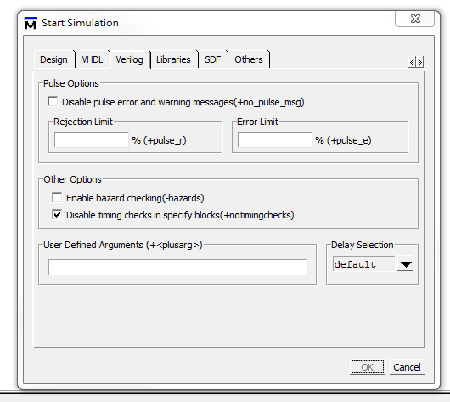
Functional Simulation by ModelSim
Step4: Start simulation
Check +notimingchecks

Slide 16
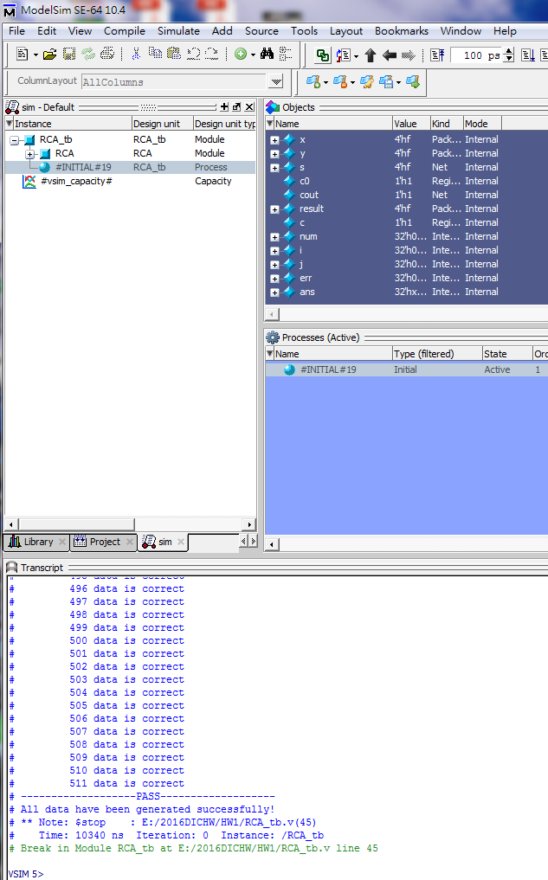
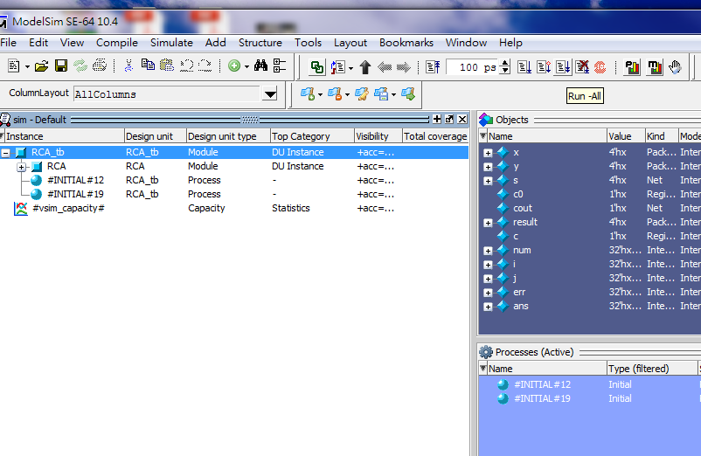
Functional Simulation by ModelSim
Step5 : Simulation
Click here

Slide 17
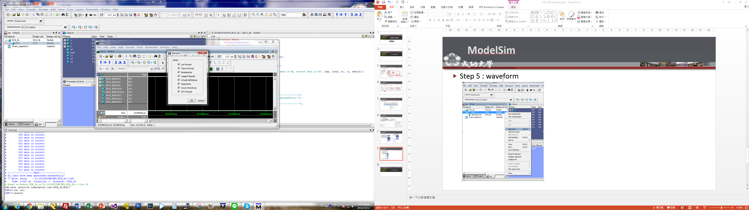
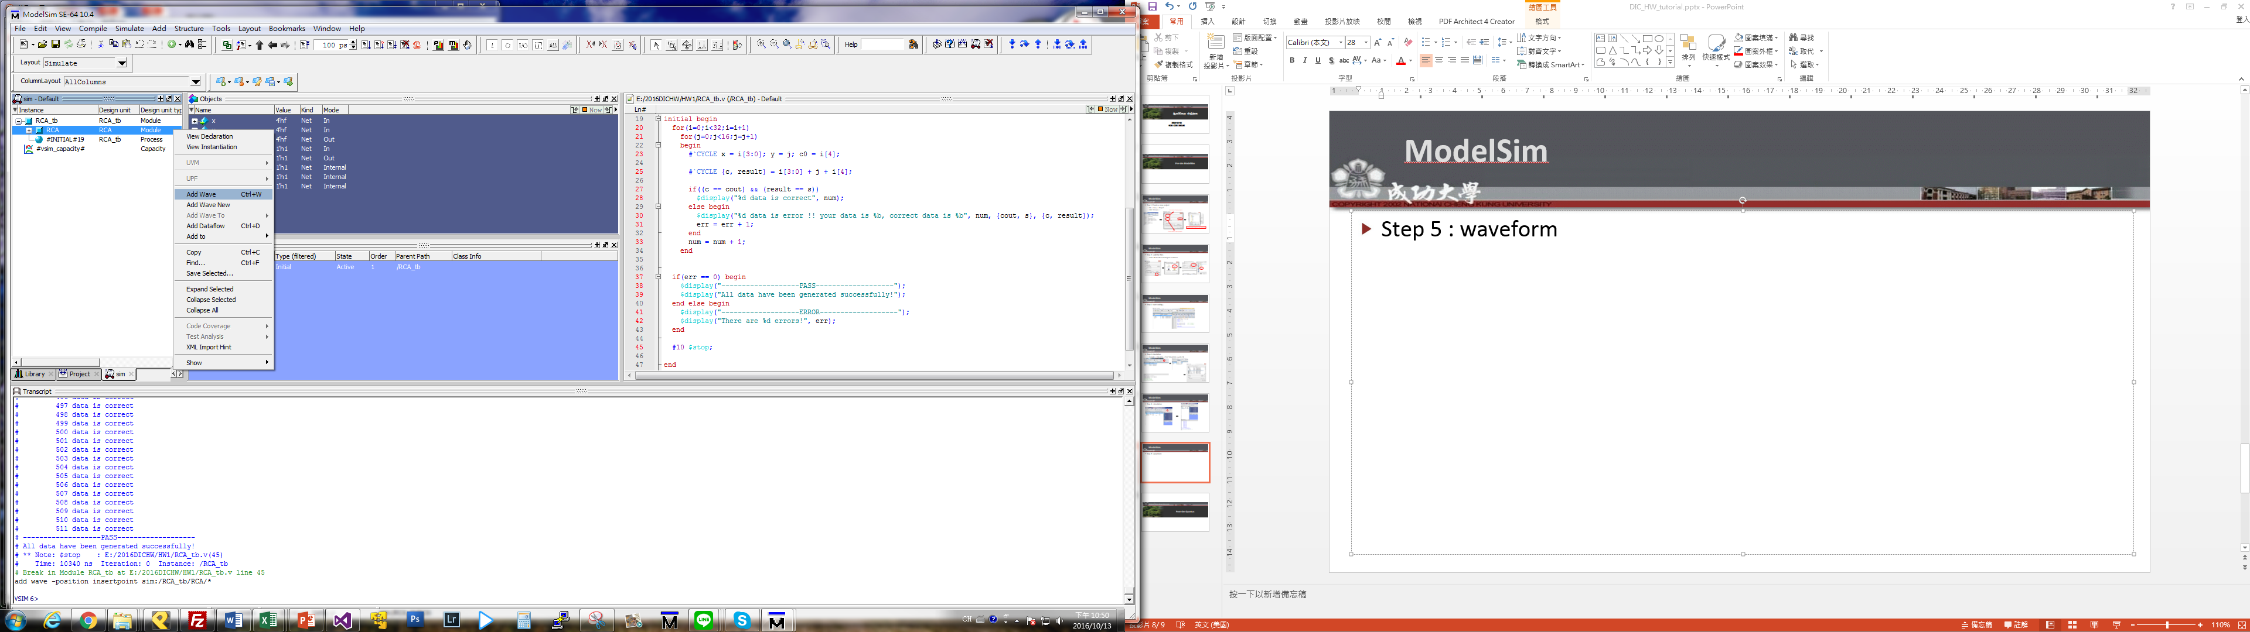
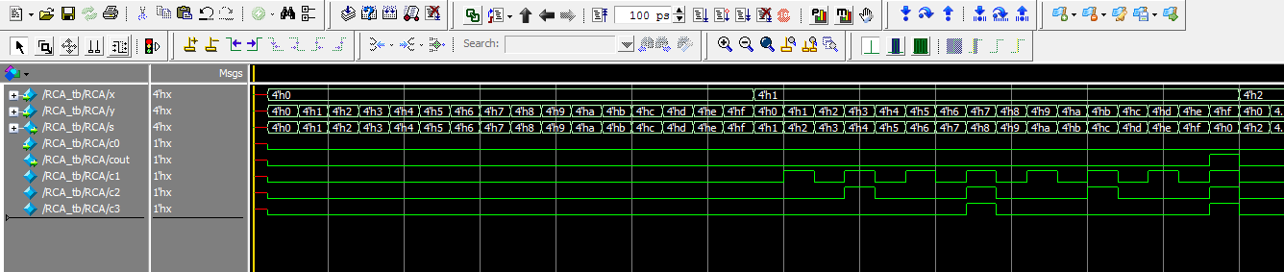
Functional Simulation by ModelSim
You have to “restart” before a new simulation
Step6 : Show waveform
Click here

